Slide 1
Odin: Crowd Simulation
Hannah Bollar and Eric Chiu

Slide 2
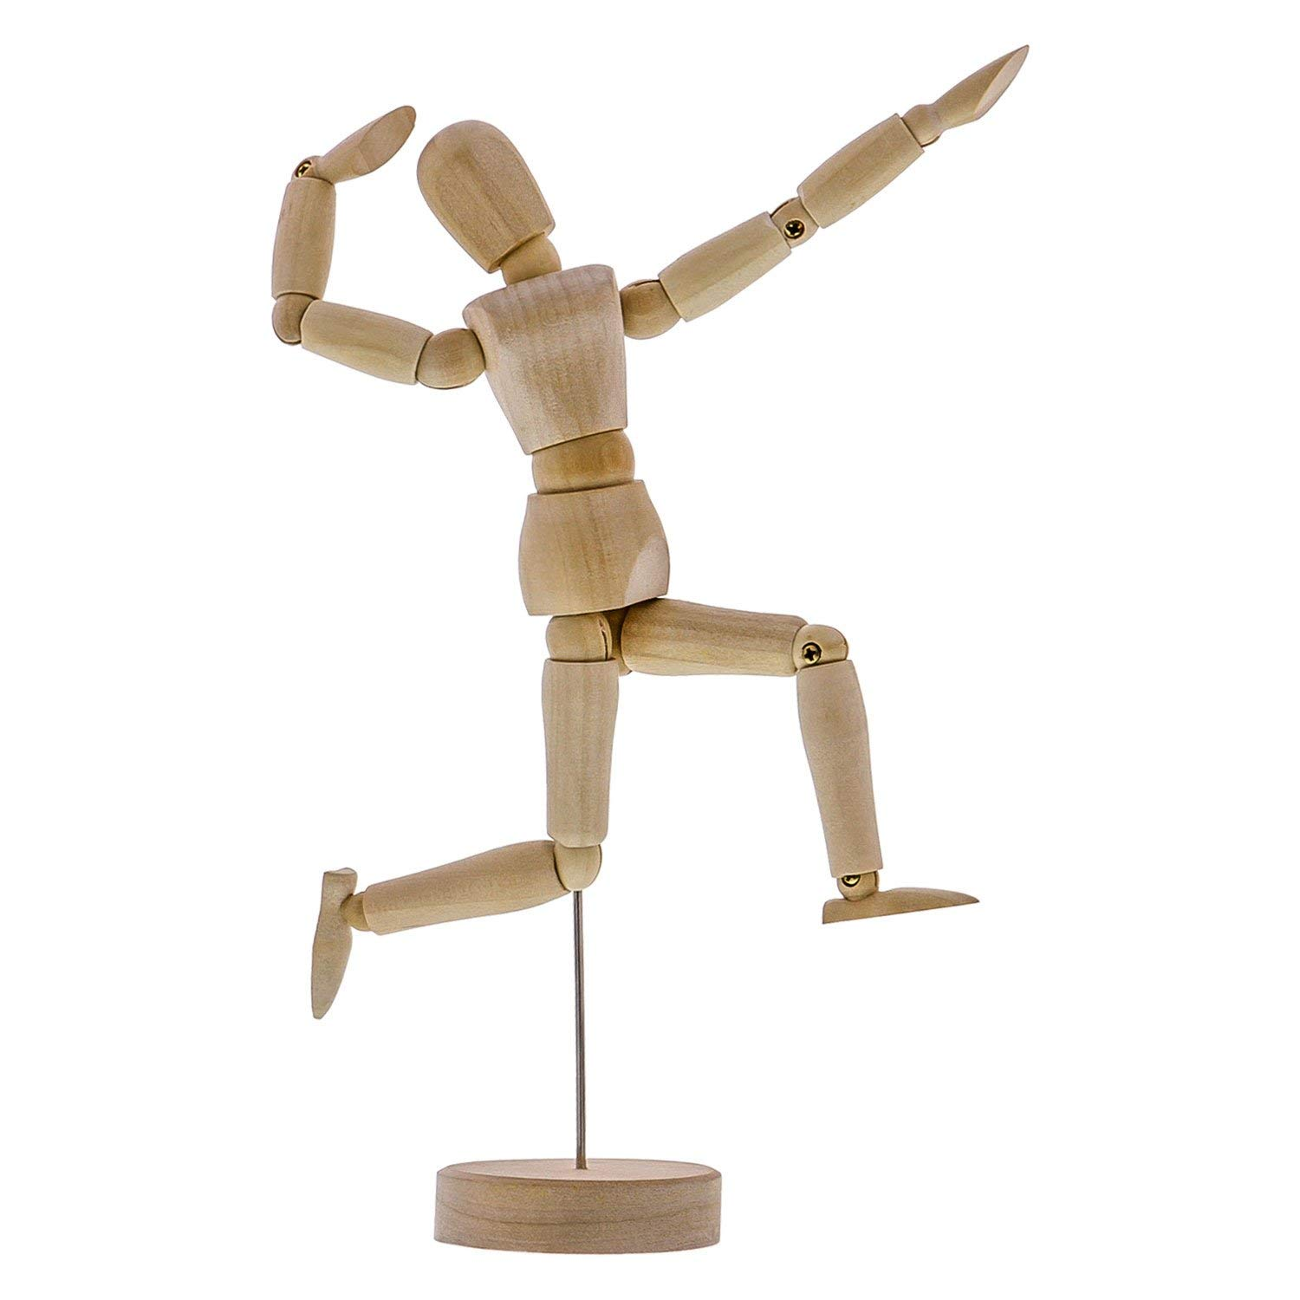

Slide 3
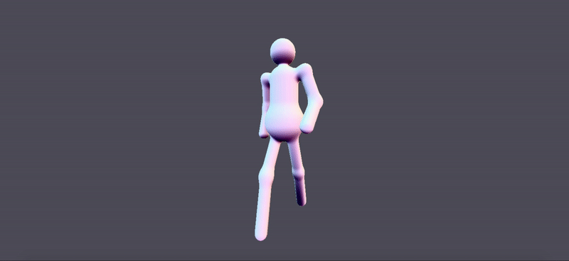

Slide 4
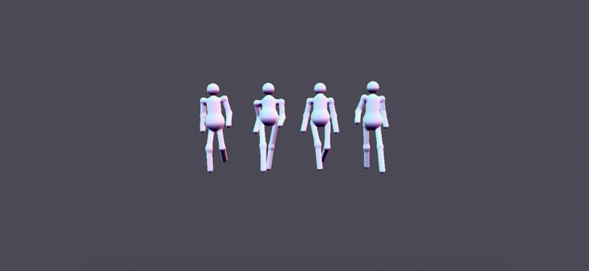

Slide 5
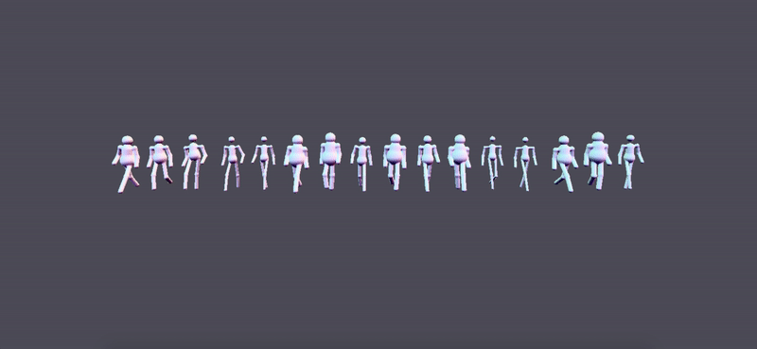

Slide 6
Optimization One: Bounding Capsules

Slide 7
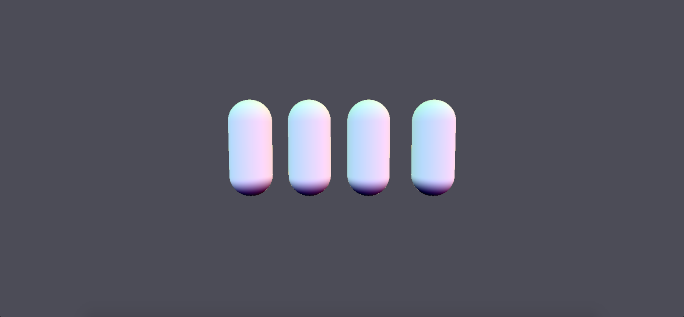

Slide 8
For every sphere tracing (ray march) step, for every agent:
If inside bounding capsule:
Else, treat agent as a single capsule sdf:
min( head sdf )
min( left bottom arm sdf )
min( left top arm sdf )
min( right bottom arm sdf )
min( right top arm sdf )
min( spine sdf )
min( belly sdf )
min( left bottom leg sdf )
min( left top leg sdf )
min( right bottom leg sdf )
min( right top leg sdf )
min( bounding capsule sdf )

Slide 9
Optimization Two: Storing Data in Texture

Slide 10
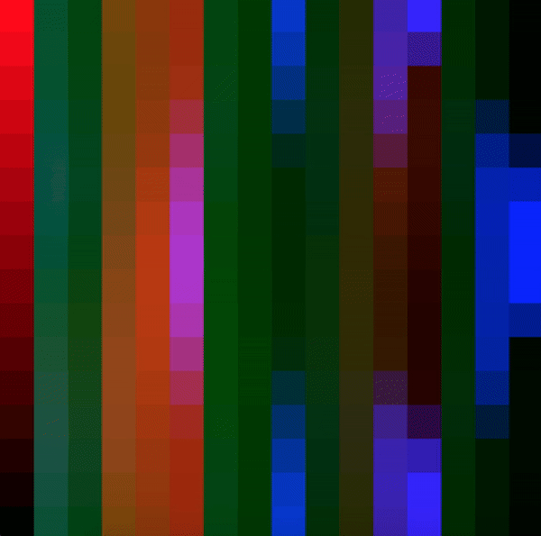
16 agents

Slide 11
16 pixels per agent
agent
world
pos
joint0
local
pos
joint1
local
pos
joint2
local
pos
...
joint11
local
pos
joint12
local
pos
joint13
local
pos
joint14
local
pos

Slide 12
Texture Shader
Crowd Shader
for each agent, calculate joint positions in world space, renders data to texture in frame buffer
perform ray-marching on signed distance functions
signed distance functions are defined by joint positions, which can be accessed through the frame buffer texture
agent positions
agent directions
time
frame buffer
output
camera
resolution
fov

Slide 13
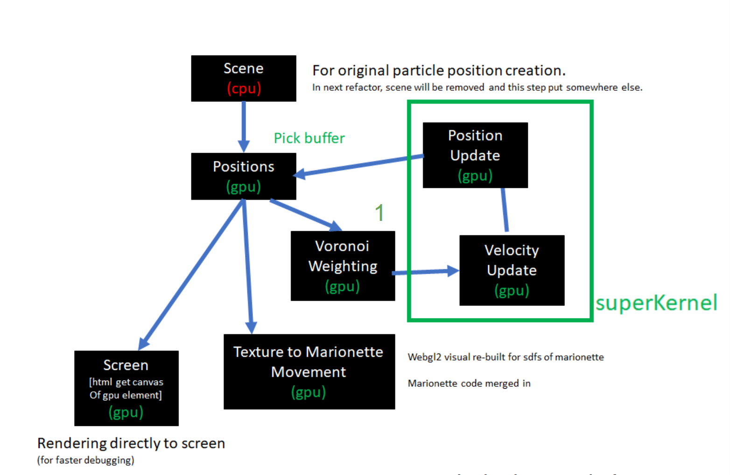

Slide 14
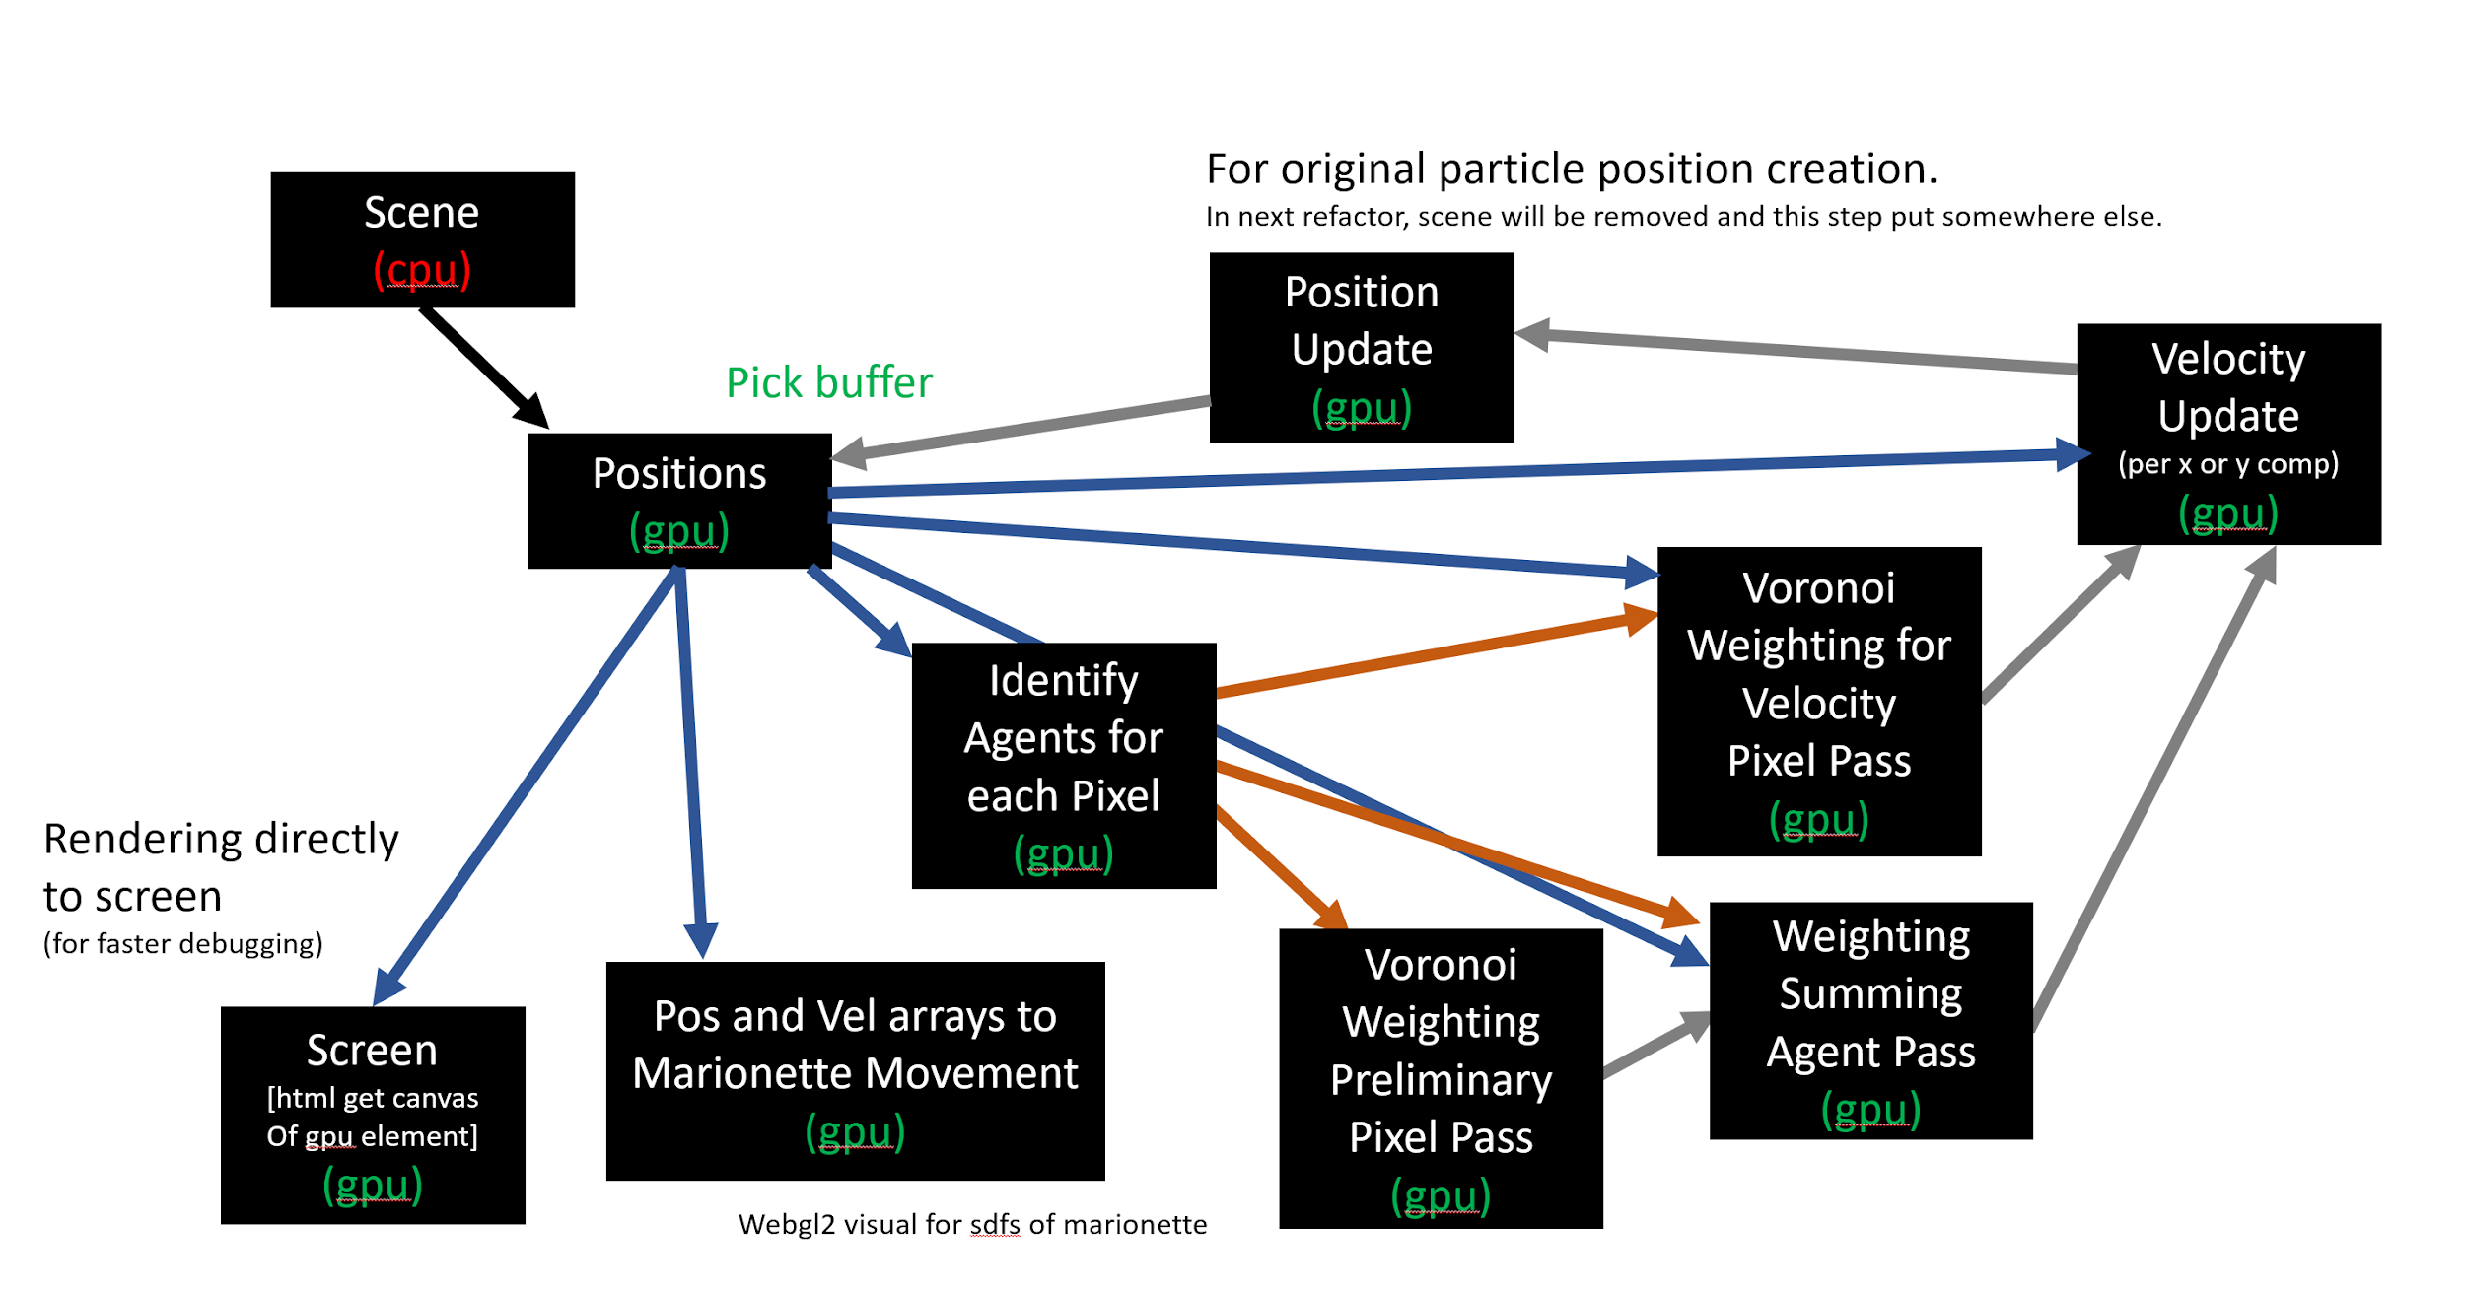

Slide 15
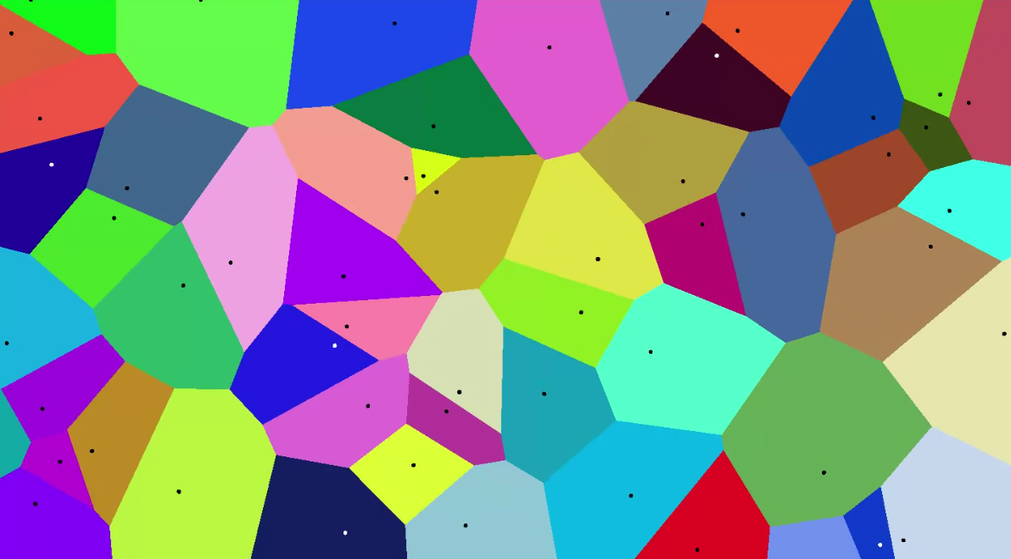
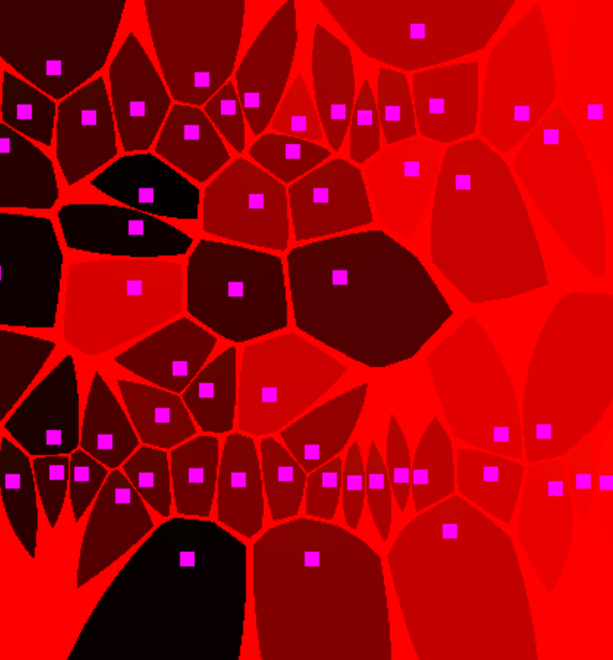
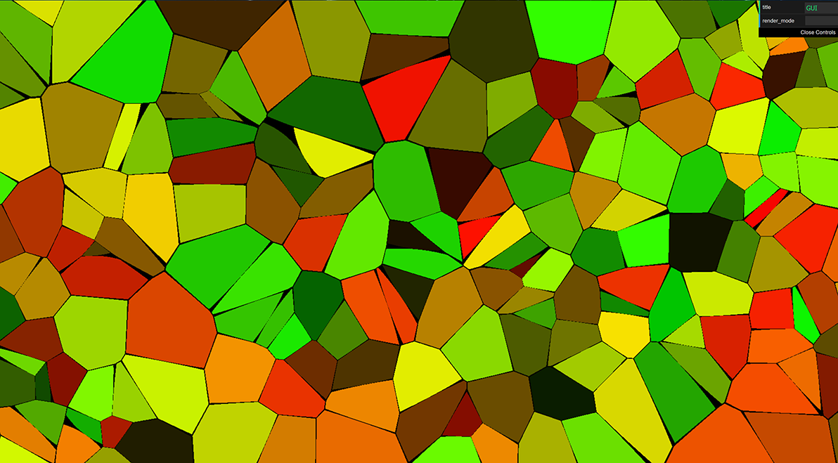
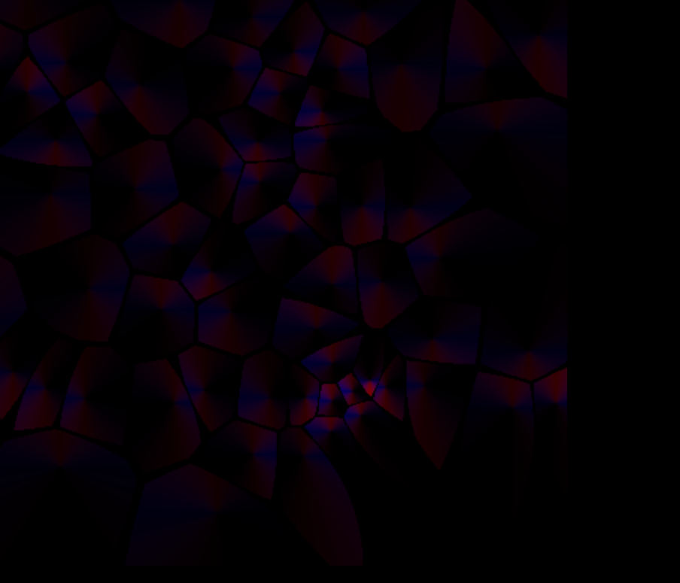
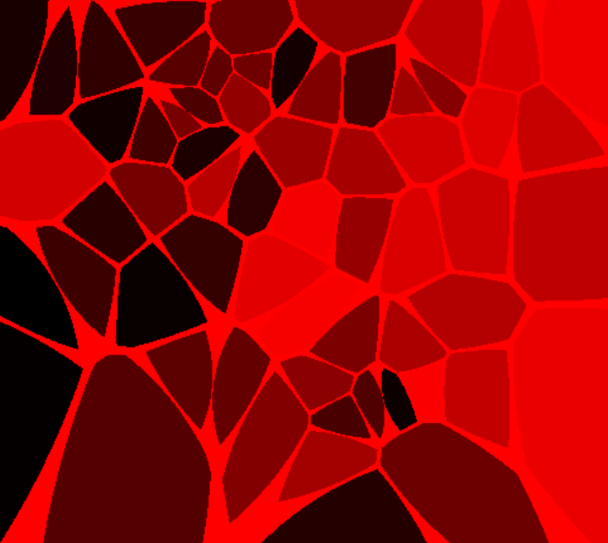
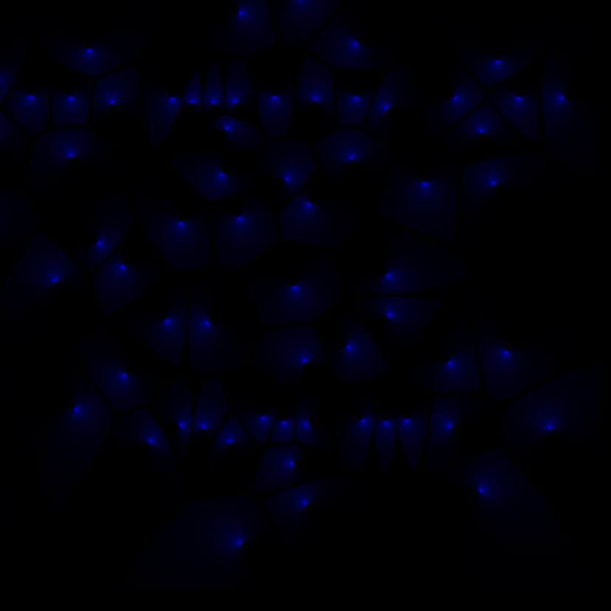
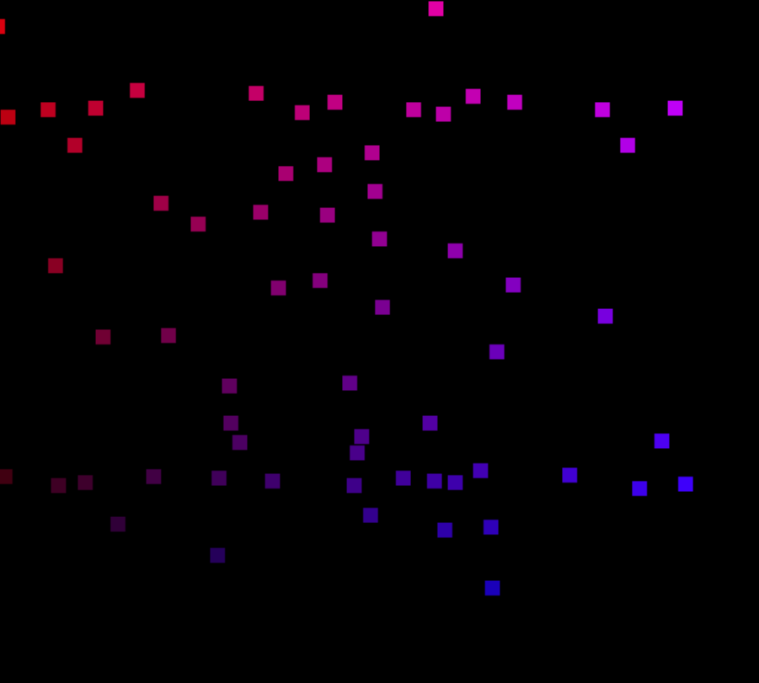

Slide 20
Demo

Slide 21
Video Gpujs views

